Slide 1
Total relevant docs = 10
Q1) Compute
11 point interpolated precision
average precision
R-precision

Slide 2
Q2) Compute Page rank scores after one iteration of algorithm.
Suppose d = 0.85
A
B
C
D

Slide 3
Q3) Write pseudo code of Page Rank algorithm that runs in O(n) time where
n = total number of web pages

Slide 4
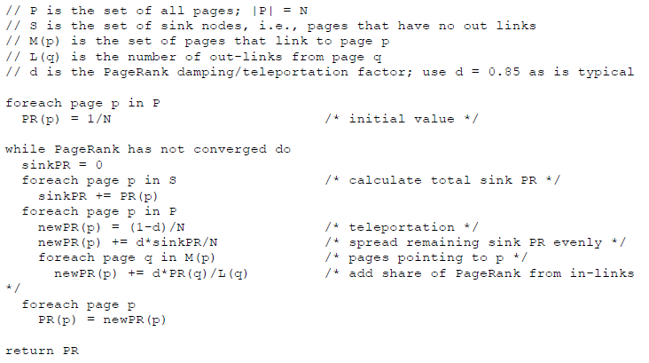
Q3 Solution

